Slide 1
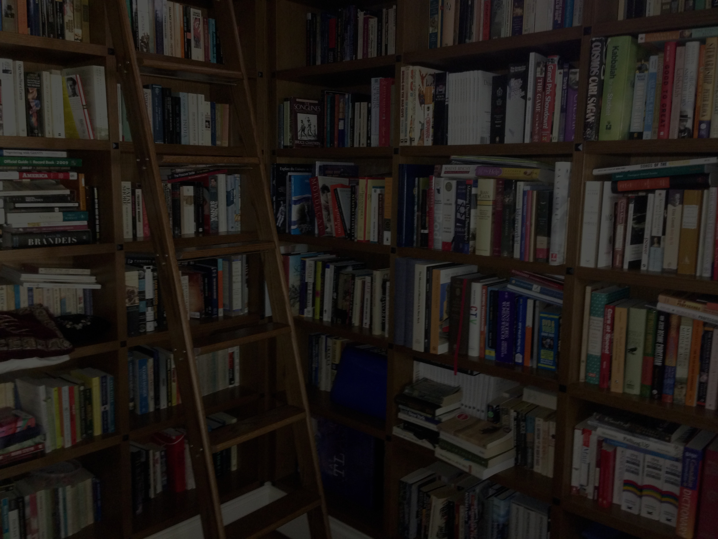

Relevance for Creative Digitization & the Internet
Roundtable on the Diversity of Cultural Expressions
Impacts & Implications of the UNESCO Convention Ten
Years After & Ten Years Ahead: The View From BC
SFU, February 25, 2014
Jon Festinger Q.C.
Professor if Professional Practice,
SFU & Centre for Digital Media;
Festinger Law & Strategy
http://videogame.law.ubc.ca
@gamebizlaw
jon_festinger@thecdm.ca

Slide 2
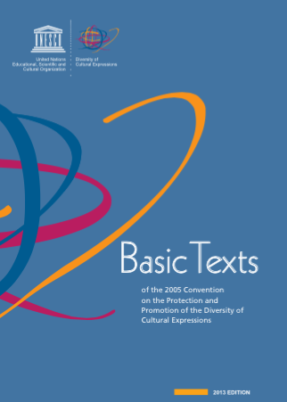
In the Preamble
“Recognizing the importance of intellectual property rights in sustaining those involved in cultural creativity,…”

Slide 3

TODAY WE HAVE…
Modding Communities
Machinima Communities
Fan Fiction Communities
Re-mix Communities
3D Printing Communities

Slide 4
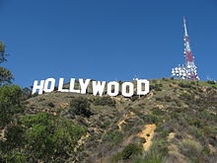


Copyright today…
The “Hollywood Model” v. the “Remix Model”
=
IP Literal-isms v. Open-Source/Fair-Use/
Public Domain-ism

Slide 5
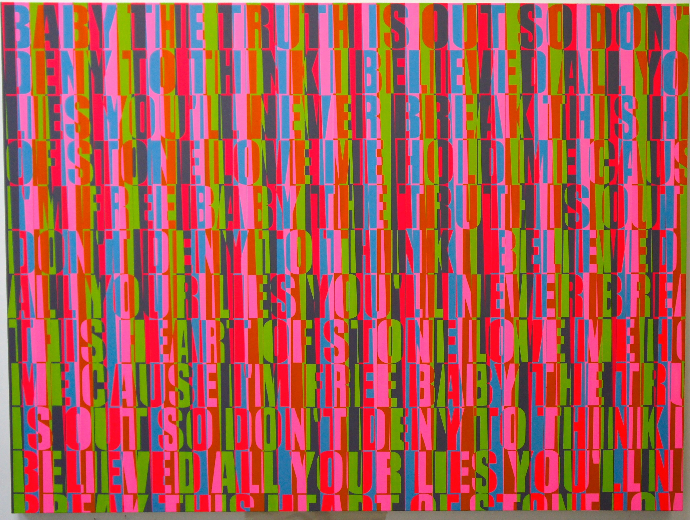
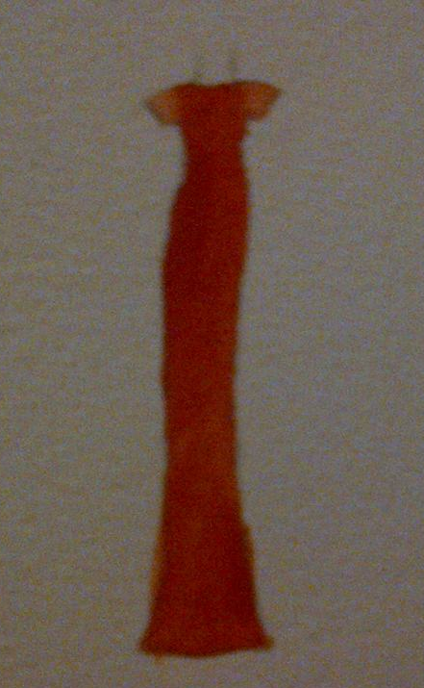
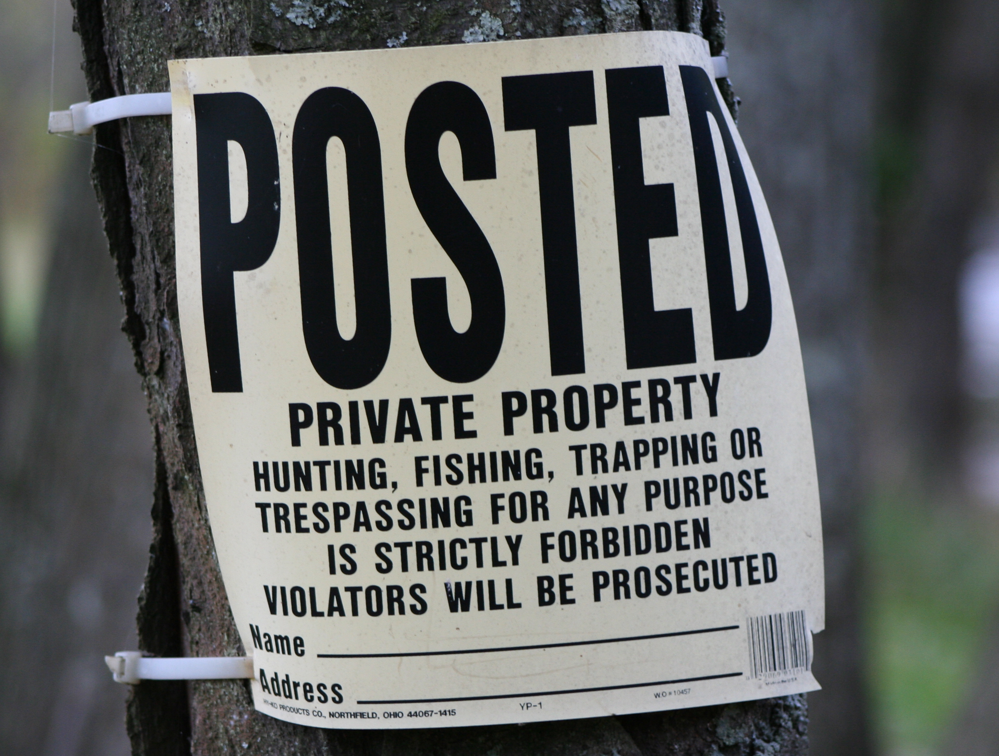
Is Creativity More
Important Than
Property ?

Slide 6
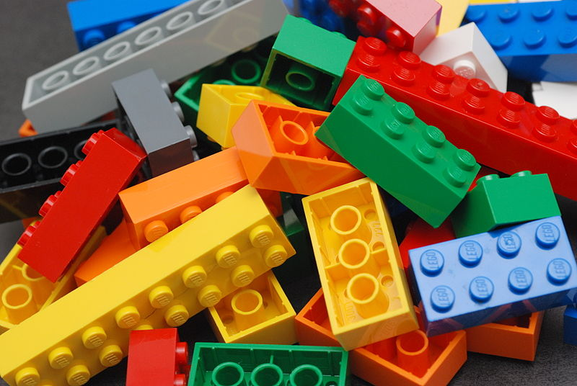
The Legal Question:
Is there a
FREEDOM TO
CREAtE
(MOD/REMIX)?

Slide 7
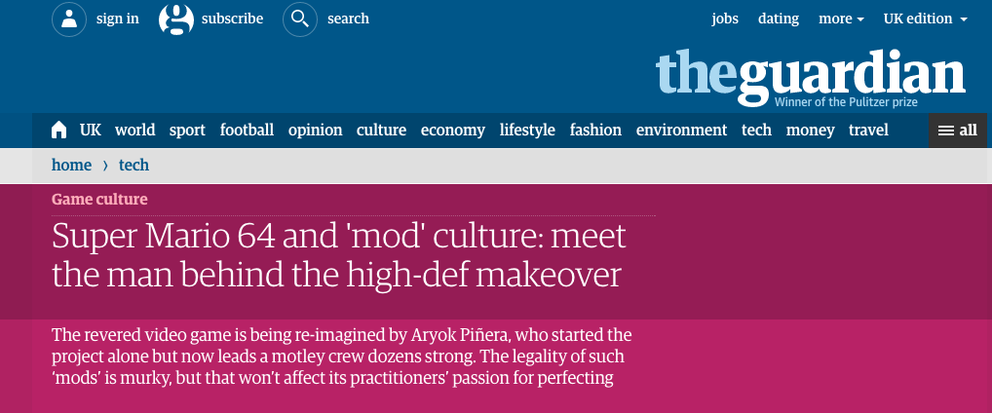
The Growing Acceptance of Mods
http://www.theguardian.com/technology/2015/feb/18/super-mario-64-high-definition-mod

Slide 8
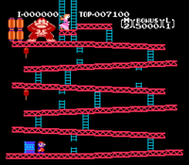
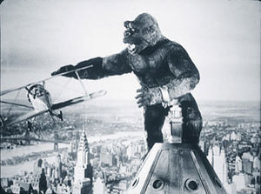
The Parable That Really Happened

Slide 9
Monkey Business/
“culture” Clash
Universal v. Nintendo, 1985 USCA
(King Kong v. Donkey Kong):
A morality tale where Hollywood asserted property rights and Nintendo defended creative integrity and independence. Donkey Kong wins. Universal didn’t have the rights. Punitive damages for Universal’s conduct awarded.

Slide 10
Questions For The Next Ten Years
1. Culture v. “culture”: Does cultural “expression” & “diversity” in the Convention come to include “new” communities and groups which the digital age enables?
Modding Communities
Machinima Communities
Fan Fiction Communities
Re-mix Communities
3D Printing Communities
2. Will it include protection from over-assertion of Intellectual Property?

Slide 11
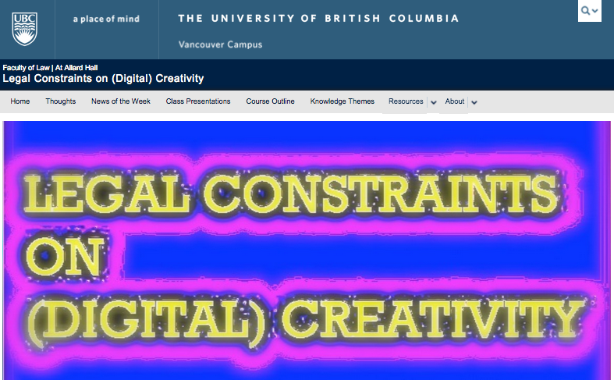
More → http://creativity.law.ubc.ca

Slide 12
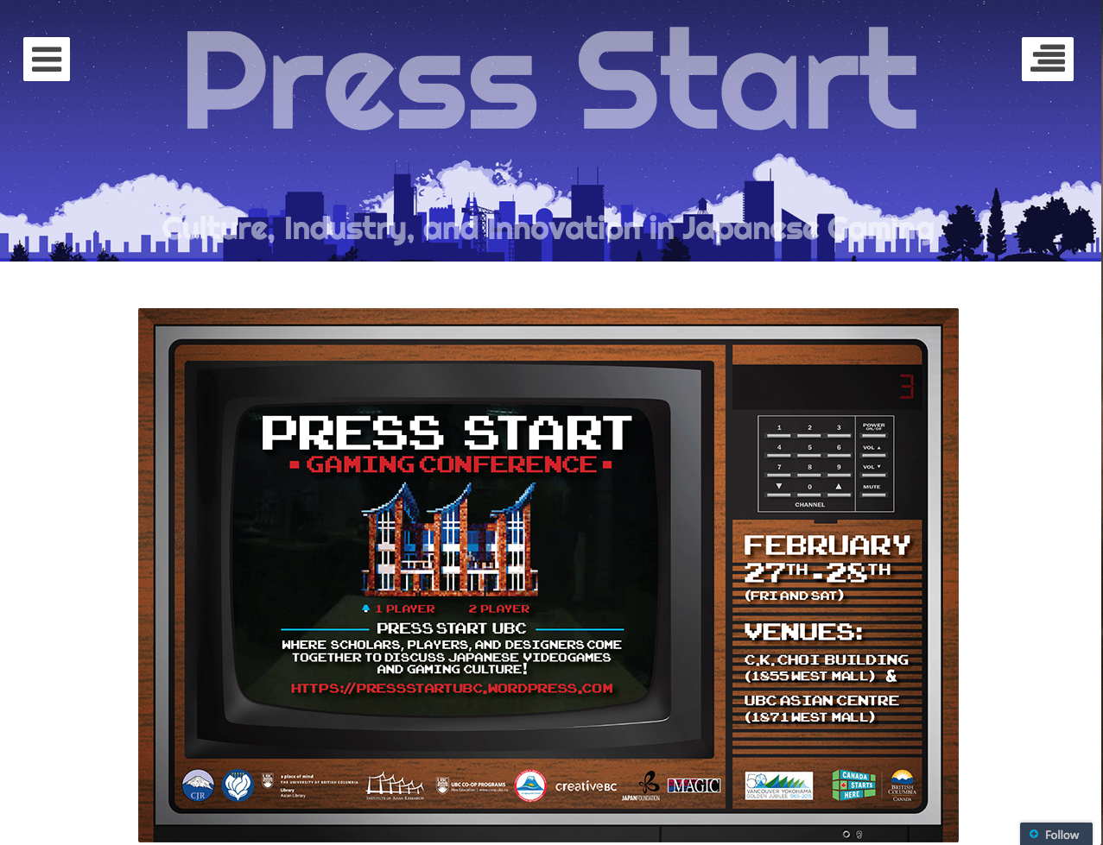
More # 2
https://pressstartubc.wordpress.com/

Slide 13

Always include a cat picture

Slide 14
Our Academic Partners

