Slide 1


Contextualizing (IP) Censorship: Considering Machinima/Remixing/FanFic
Legal Constraints on (Digital) Creativity
Classes 5 & 6 –
Copyright Law & Remixing: Constraints & Constructions
UBC Law @ Allard Hall
Jon Festinger Q.C.
Centre for Digital Media
Festinger Law & Strategy
http://videogame.law.ubc.ca
@gamebizlaw
jon_festinger@thecdm.ca

Slide 2
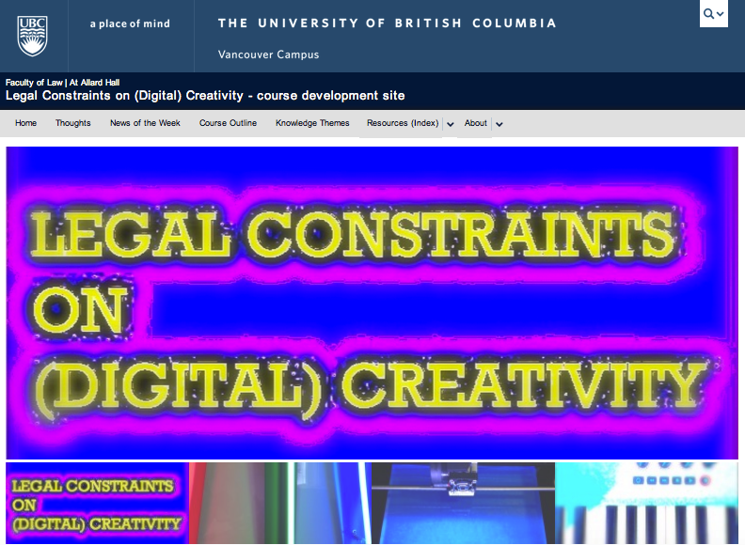
Website: How goes?

Slide 3

How goes?

Slide 4

Today: Solving Copyright
Once & For All

Slide 5
When Law Slows Tech Down:
What’s It All About, Really?
Copyright
Creativity
Control
Incumbancies
$$$
Which is in service to which?

Slide 6
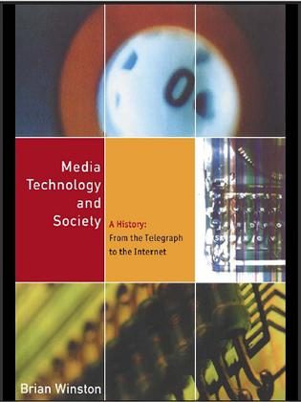
An answer?
Technologies evolve over time, with their 'invention’ mediated and controlled by society and societal factors which suppress the radical potential of any particular technology.

Slide 7
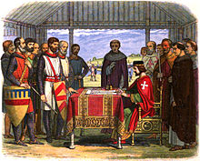
But surely the Rule of
Law will save us ?!!

Slide 8

Because…
THE LAW SEEMS TO RESPOND SO VERY SLOWLY TO TECHNOLOGICAL CHANGE.

Slide 9
Consider the possibility...
…that concepts of Law & Justice can never adequately resolve issues related to communications because…technologies have a role in proactively defining how we communicate…and therefore the future meanings of Justice & the forms Law will take.

Slide 10
Technology /Justice (Parallels)?
Before Justice was Revenge
1. Pre-literate => Justice as Retribution
2. Writing Instruments =>Justice as Compensation
3. Printing Press => Justice as Rights
4. Mass Media => Justice as Truth
5. Digital => Justice as Resolution
6. Big Data=>Justice as (Individual) Boundaries
7. Virtual reality => Freedom of Thought

Slide 11
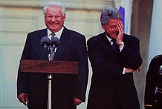
Back To: Solving Copyright
Once & For All

Slide 12
Useful Perspective:
Constraints Distort Creativity
10. Internet Governance & Surveillance (International Law)
9. Taxation/Currency/Gambling/Criminal/Obscenity
(Criminal & Quasi Criminal)
8. Misleading promises/advertising, physical or
psychological harm, unfair competition/anti-trust
(consumer protection)
7. Industry self regulation (delegated authority) & medium
specific regulation (constitutional)
Out of the Creation Norms (Censorship) ----------------------------------------------------------------------------------------------------------------
In the Creation (Magic Circle) Ethics (of Originality, Creativity & Expression)
6. Privacy, Defamation & Personality law (tort, IP)
5. EULA/ToS & Contracts (contractual, private)
4. Trademark, Patents & the IP Business
3. Copyright & Users Rights (statutory) ← ← ← ← WE ARE HERE
2. Technology (quasi extra-legal)
1. Community (extra-legal)

Slide 13

Prior Restraints Are A Problem
Blackstone: “Every freeman has an undoubted right to lay what sentiments he pleases before the public; to forbid this, is to destroy the freedom of the press;…” (4 Bl. Com. 151, 152.)
*IP as “Prior Restraint” to Creativity?

Slide 14
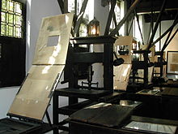
Defining the Problem:
Starts here…
Printing Press 1570

Slide 15
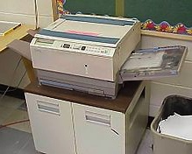
And goes here…

Slide 16
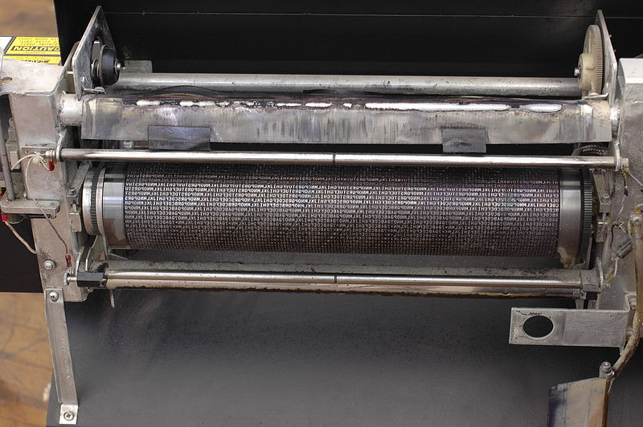
SHOULD…
“Copy”
in“Copyright”
just mean
“copy”?

Slide 17
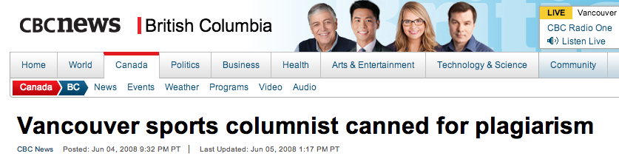
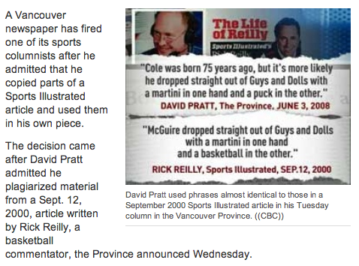
Can we agree:
Plagiarism is out of bounds

Slide 18
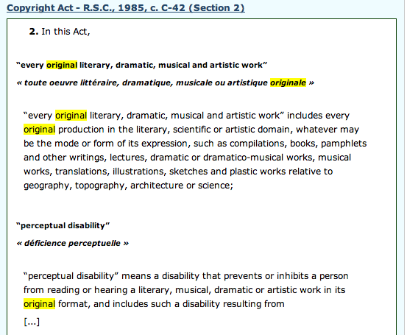
Next: Core value = Originality (?)

Slide 19
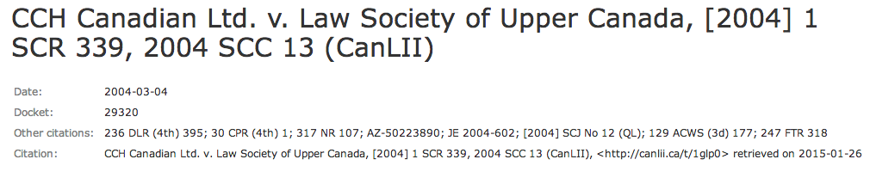
Undefined (in Act) but…
Somewhere between “sweat of the brow” (Lockian) and “creativity”. Skill and judgment that is more than trivial or mechanical is needed. Requires “intellectual effort”.

Slide 20
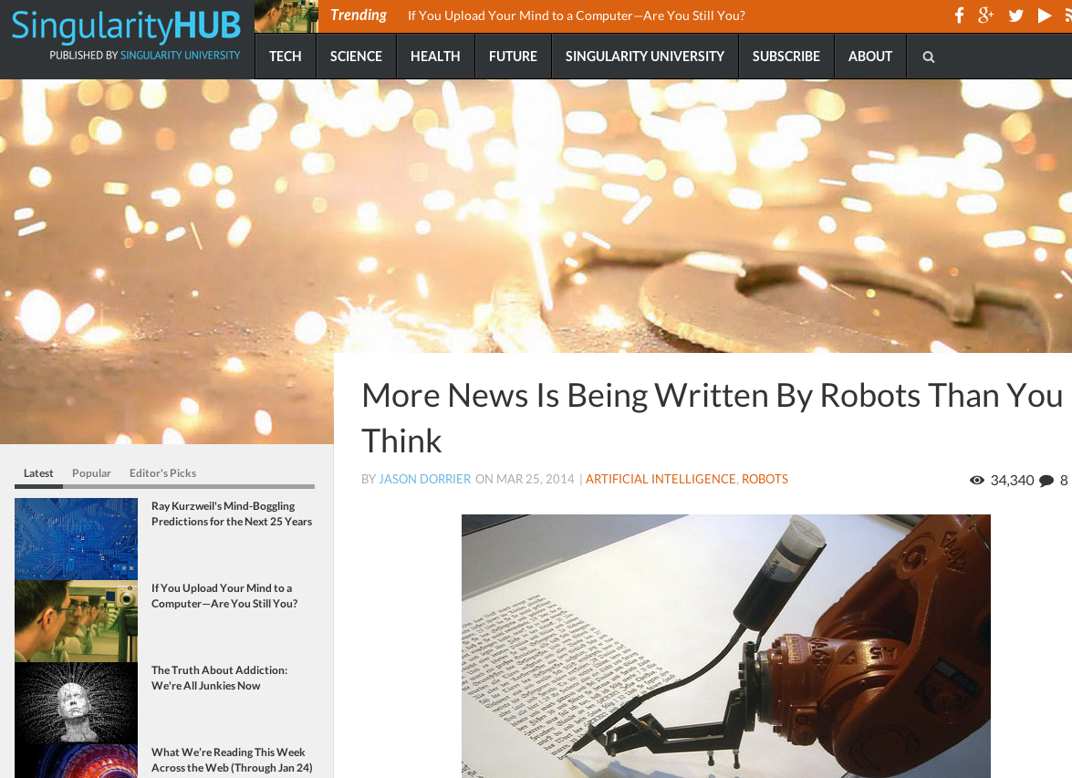
Writing bots un-protectable?

Slide 21
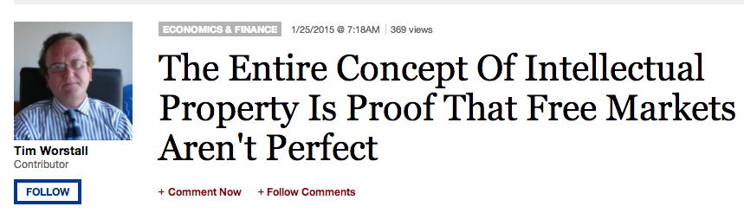
Back to “Originality” → economics?
Acknowledges we currently protect original creation too much… and don’t leave enough room for derivative creation…and so proposes to add a new layer of copyright for derivative creation (!??)

Slide 22
What’s wrong with this picture?
THE “MECHANIC” IS BASED ON THE COMMODITY NOT THE CREATIVITY
Policy statements are about “…encouraging creativity” but the law is essentially related to its commercial liquidity.
The only assumption is that creativity must exist, and that is only ever implied, not expressed in Copyright Act.

Slide 23
Does “Originality” mean…
CREATOR
or
CONNECTOR

Slide 24
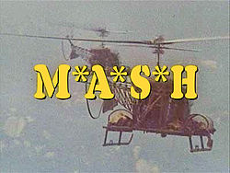
Must mean CONNECTOR
Low threshold. Does not sound like:
“The creative is the place where no one else has ever been. You have to leave the city of your comfort and go into the wilderness of your intuition. What you’ll discover will be wonderful. What you’ll discover is yourself.” (Alan Alda)

Slide 25
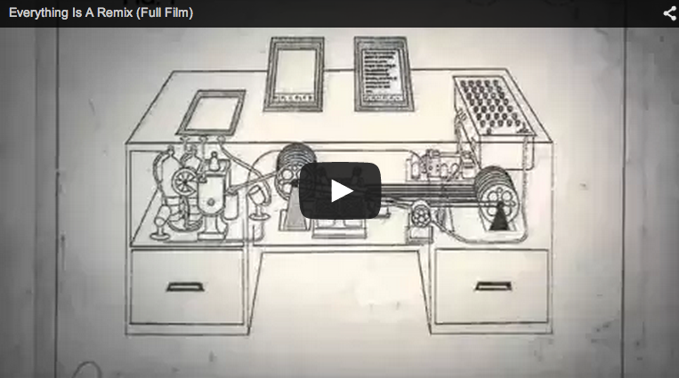
Is “original” in law consistent with the “connector” meme?

Slide 26
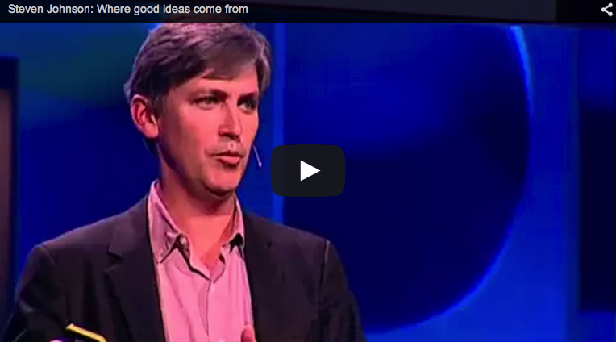
Moreover…

Slide 27
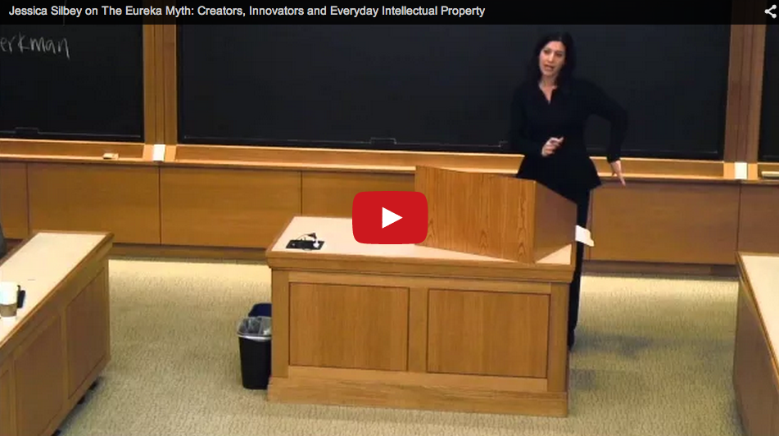

Slide 28
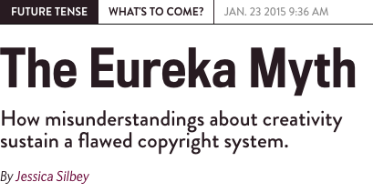
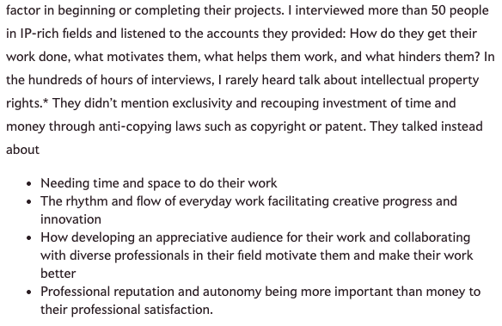
http://www.slate.com/articles/technology/future_tense/2015/01/the_eureka_myth_confusion_about_creativity_and_our_flawed_ip_system.html

Slide 29
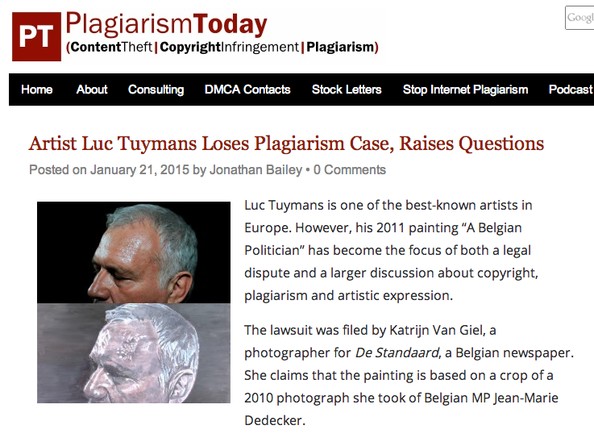
So what about…?

Slide 30
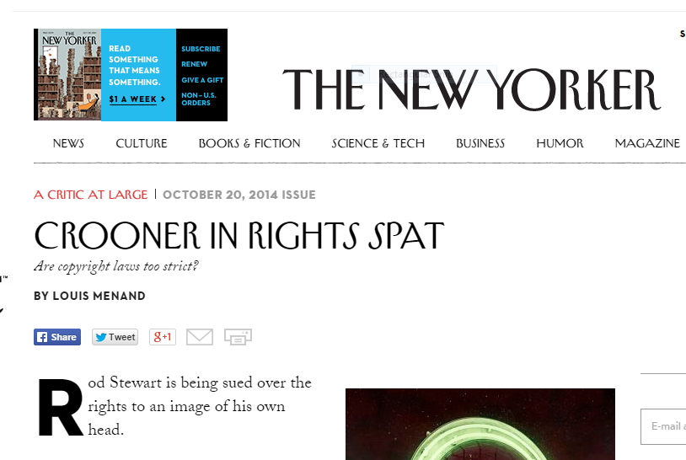
Or…
http://www.newyorker.com/magazine/2014/10/20/crooner-rights-spat

Slide 31
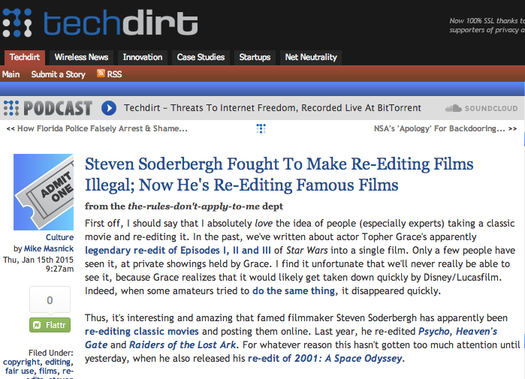
The answer? Double standards.

Slide 32
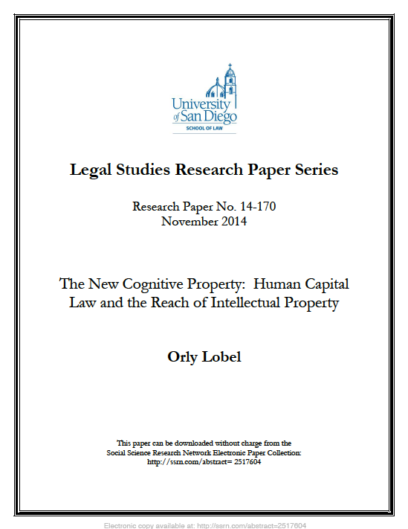
Another Angle:

Slide 33

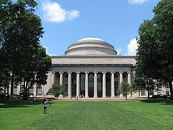
Silicon Valley Success v. Boston Tech Stasis: About law effectively prohibiting restrictive covenants on employee movement in California?
Stanford
MIT

Slide 34
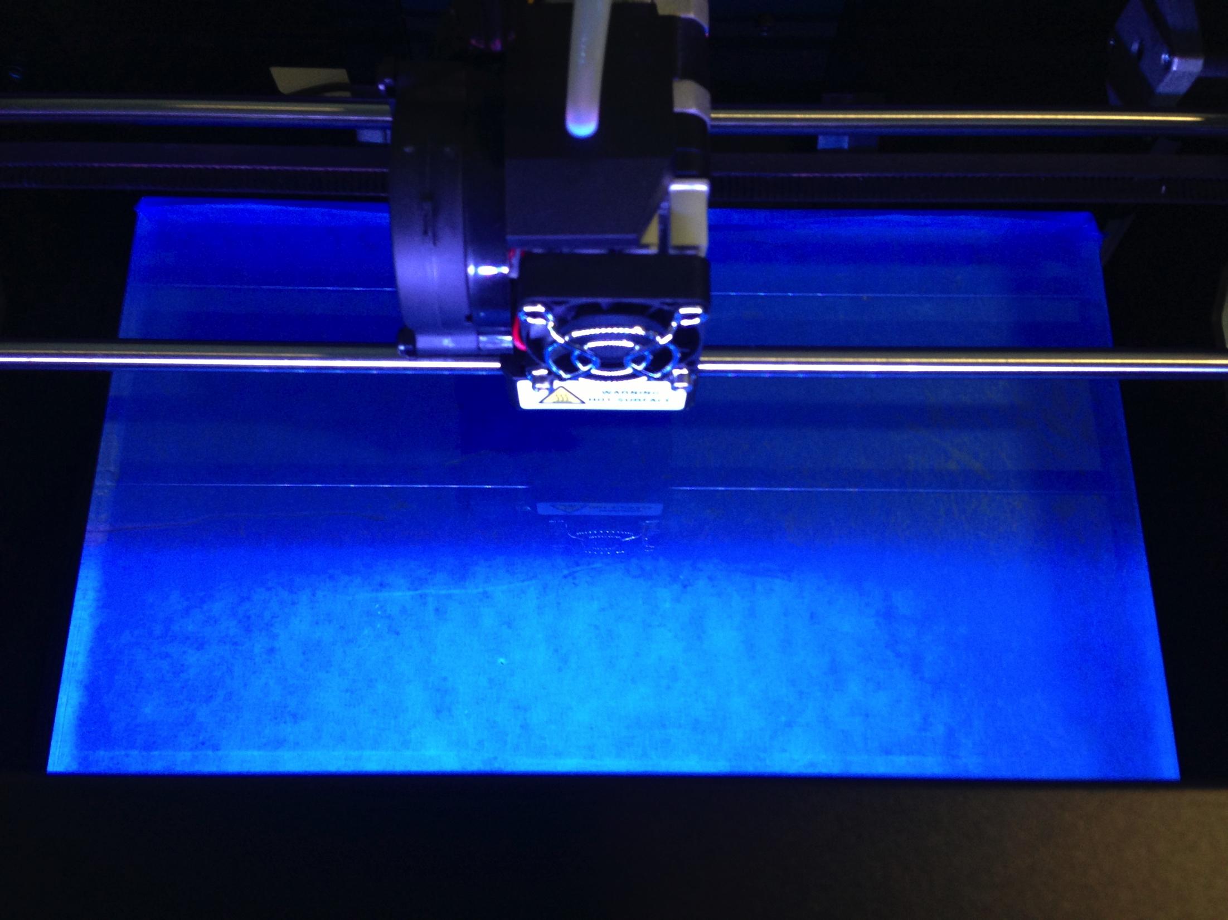
What’s at stake?
Mods
Machinima
Fan Fiction
Re-mix
Multi-source content
3D Printing

Slide 35
How do we update “Derivative Rights” for the Digital Age? (current provisions)
3. (1) For the purposes of this Act, “copyright”, in relation to a work, means the sole right to produce or reproduce the work or any substantial part thereof in any material form whatever, to perform the work or any substantial part thereof in public or, if the work is unpublished, to publish the work or any substantial part thereof, and includes the sole right
  (a) to produce, reproduce, perform or publish any translation of the work,
  (b) in the case of a dramatic work, to convert it into a novel or other non-dramatic work,
  (c) in the case of a novel or other non-dramatic work, or of an artistic work, to convert it into a dramatic work, by way of performance in public or otherwise,
  (d) in the case of a literary, dramatic or musical work, to make any sound recording, cinematograph film or other contrivance by means of which the work may be mechanically reproduced or performed,
  (e) in the case of any literary, dramatic, musical or artistic work, to reproduce, adapt and publicly present the work as a cinematographic work,
  (f) in the case of any literary, dramatic, musical or artistic work, to communicate the work to the public by telecommunication,
  (g) to present at a public exhibition, for a purpose other than sale or hire, an artistic work created after June 7, 1988, other than a map, chart or plan,
  (h) in the case of a computer program that can be reproduced in the ordinary course of its use, other than by a reproduction during its execution in conjunction with a machine, device or computer, to rent out the computer program,
  (i) in the case of a musical work, to rent out a sound recording in which the work is embodied, and
  (j) in the case of a work that is in the form of a tangible object, to sell or otherwise transfer ownership of the tangible object, as long as that ownership has never previously been transferred in or outside Canada with the authorization of the copyright owner,
and to authorize any such acts.

Slide 36
U.S. Copyright Act
A “derivative work” is a work based upon one or more preexisting works, such as a translation, musical arrangement, dramatization, fictionalization, motion picture version, sound recording, art reproduction, abridgment, condensation, or any other form in which a work may be recast, transformed, or adapted. A work consisting of editorial revisions, annotations, elaborations, or other modifications which, as a whole, represent an original work of authorship, is a “derivative work”.

Slide 37

Problem applies to…
Fan Fiction

Slide 38
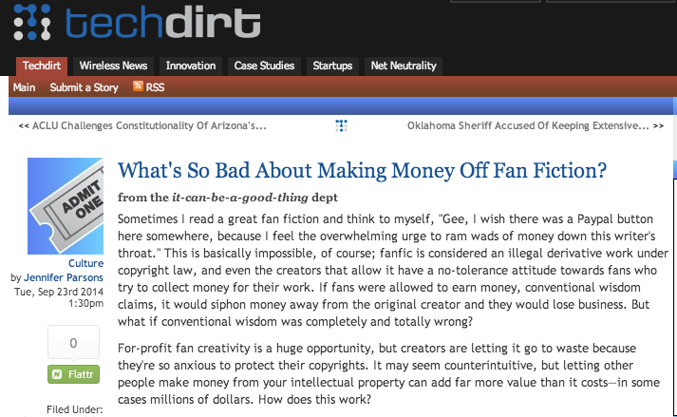
https://www.techdirt.com/articles/20140821/21532628289/whats-so-bad-about-making-money-off-fan-fiction.shtml

Slide 39
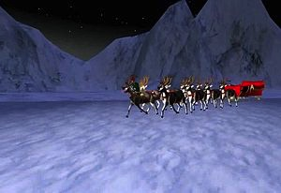
Machinima in Second Life

Slide 40
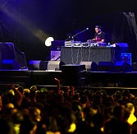
Remixing

Slide 41
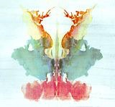
What is “originality” anyway?
Rorschach test

Slide 42
Video Games as a practical example:
Originality Quest ***
The Game

Slide 43
WHAT IS AN
“ORIGINAL”
GAME (IN
Law)?

Slide 44
STEP 1

Slide 45
First key is the…
IDEA/
EXPRESSION
DICHOTOMY

Slide 46
STEP 2

Slide 47
THE IP
THRESHOLD
FOR GAMES
(LOW)

Slide 48
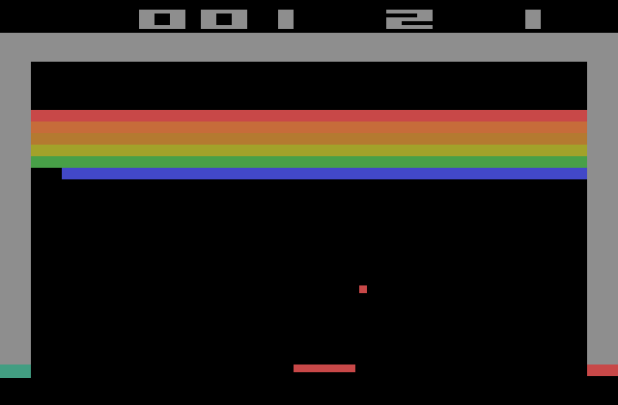
BREAKOUT
Issue: The “creativity standard” in copyright.
Atari v. Oman - 1989/1992 USCA DC Cir.

Slide 49
STEP 3
Copyright

Slide 50
    No protection for:
    general concepts, plots,
    themes and genres;
    scenes a faire, ideas
    “merged” with
    expression; content not
    original to the author

Slide 51
Meaning no protection for:
    basic game concept, rules, method of play, stock characters, common sports moves, other aspects of games “driven by genre”

Slide 52
Games
as opposed to
Video-games
are not
copyrightable.
WHY NOT?

Slide 53
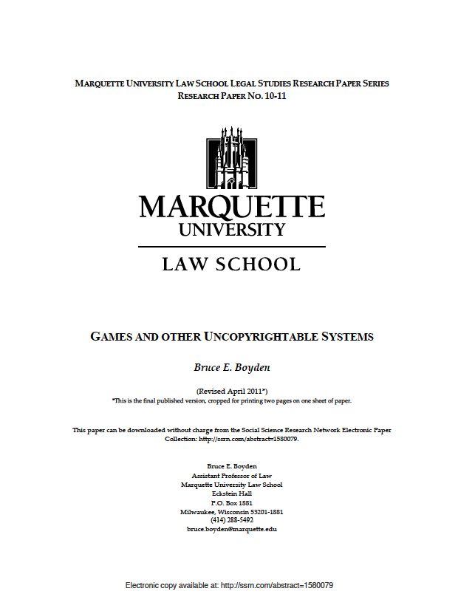

Slide 54
You as provider of meaning: Boyden
“In all of these situations, the owners of a copyright in a form, description, or set of instructions were attempting to extend their copyright to material for which the user of the work provided the essential content, not its author. That is what made them systems. They were, without that input, empty shells, waiting to be filled.”
“Games are systems in exactly the same way. A game, as sold, is only a game form; the content necessary for an instance of the game comes from the players. That is, the game form establishes the environment for play—the game space—and it defines permissible moves and the conditions for winning or drawing. But the game itself is supplied by the players.”
“Systems are shells into which users pour meaning. While they may contain expression themselves, that expression is there merely to facilitate the meaning added by the user.”

Slide 55
STEP 4
What is protectable…

Slide 56
      “look and feel”, game
      progression, graphics,
      instructions
      (verbatim), underlying
      code, storyline,
      sounds
      can be protected

Slide 57
STEP 5
Defenses:
Copyright invalidity;
Independent creation;
Fair dealing/ use.

Slide 58
Summary of Copyright Analysis
Step 1: Identify game’s genre and others that fall into it
Step 2: Identify un-protectable aspects of such games
Step 3: Compare the games

Slide 59
EXAMPLES…

Slide 60
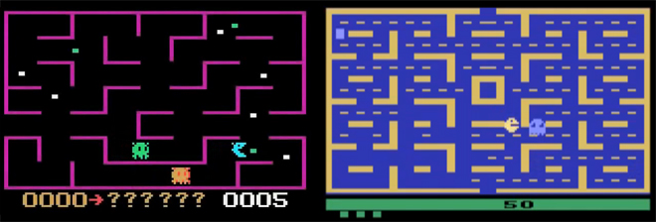
K.C. Munchkin & Pac-Man
Atari (Pac-Man wins before USCA

Slide 61
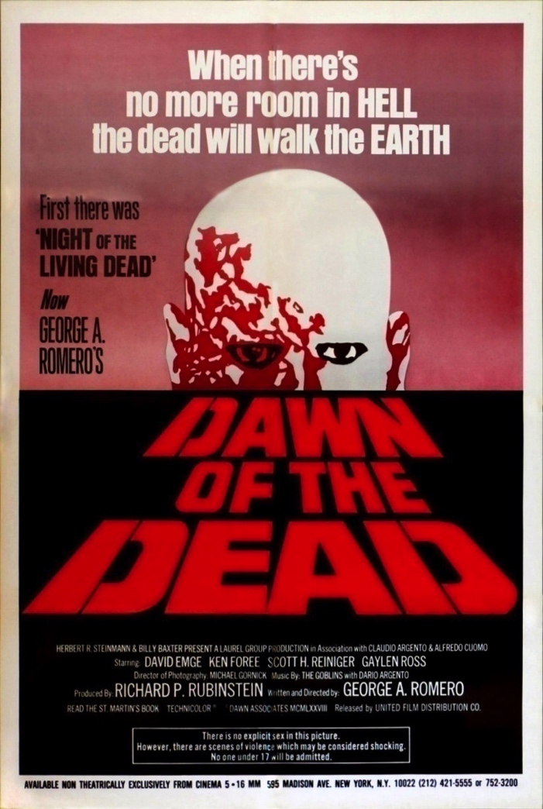

Dawn of the Dead & Dead Rising
Dead Rising wins in U.S. Dist. Ct..

Slide 62
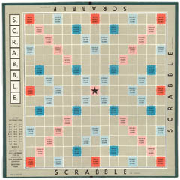
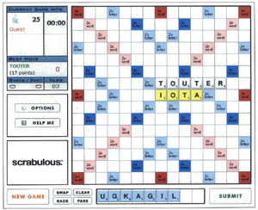
Scrabble & Scrabulous
Scrabulous shuts itself down

Slide 63
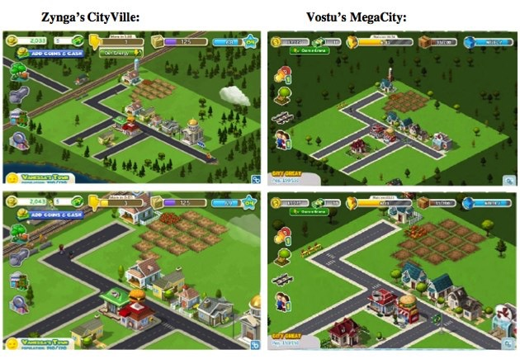
Cityville & MegaCity

Slide 64
Scrabble & Scrabulous
Scrabulous shuts itself down

Slide 65
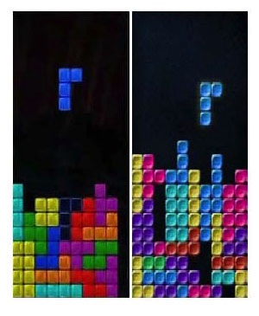
Tetris & Mino
Tetris wins in U.S. Dist. Ct..

Slide 66
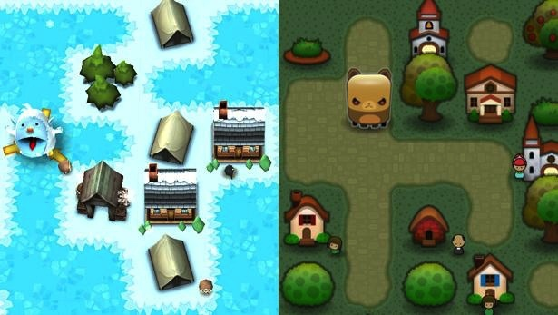
Triple Town & Yeti Town
Settlement resulting in the transfer of Yeti Town's
copyright to Spry Fox.

Slide 67
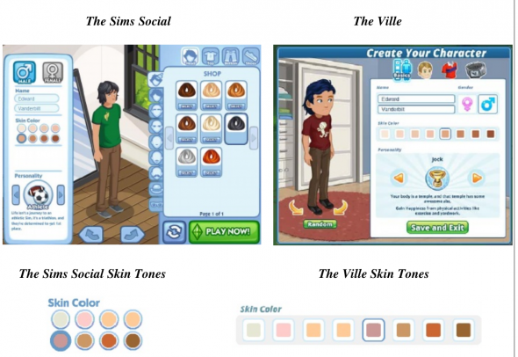
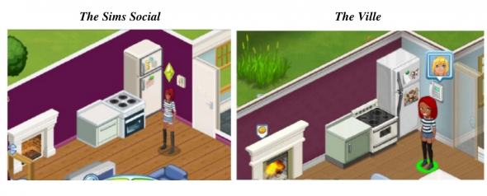
Sims Social & The Ville
Settled on unknown terms.

Slide 68
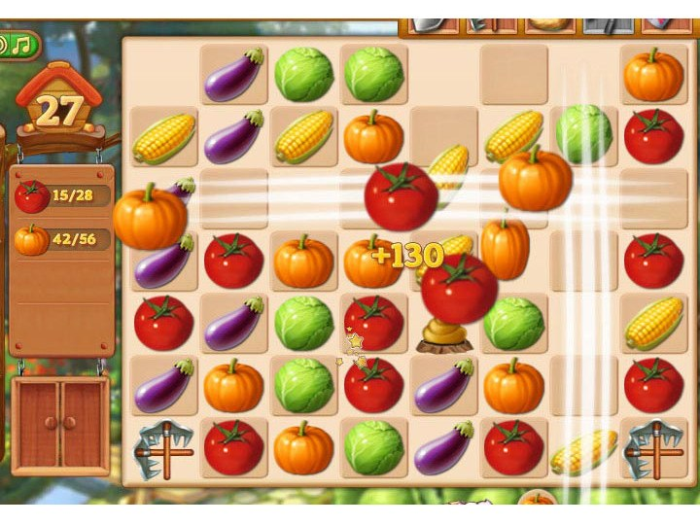
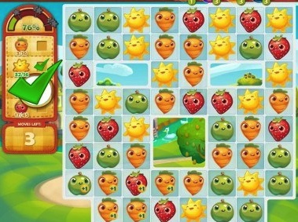
Farm Heroes Saga & Farm Epic
6Waves removes Farm Epic from the Web as part of the out-of-court agreement it reached with King.

Slide 69
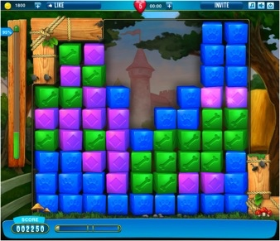
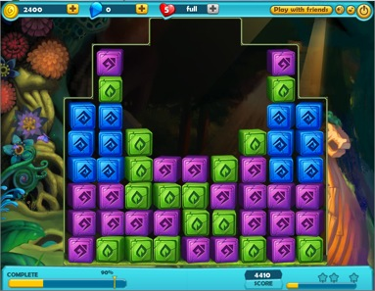
Pet Rescue Saga & Treasure Epic
6Waves removes Treasure Epic from the Web as part of the out-of-court agreement it reached with King.

Slide 70
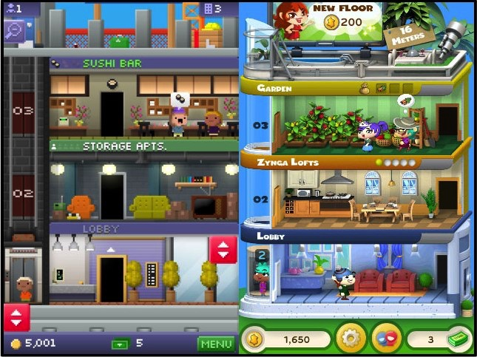
Tiny Tower & Dream Heights
Tiny Tower Developers Call Out Zynga For Copying Their Game (After They Refused To Be Acquired)

Slide 71
Tiny Tower & Dream Heights
Tiny Tower Developers Call Out Zynga For Copying Their Game (After They Refused To Be Acquired)

Slide 72
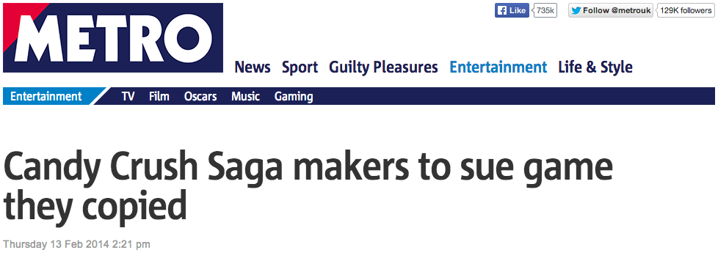
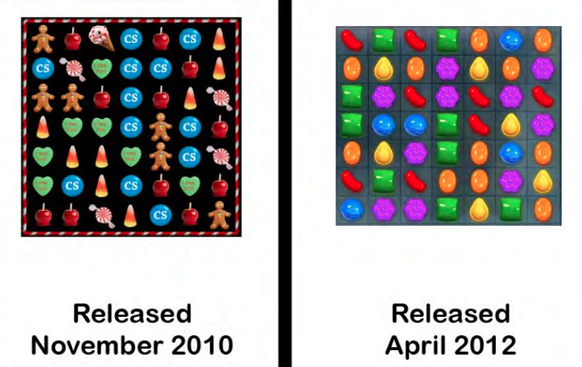
Candy Crush 1

Slide 73
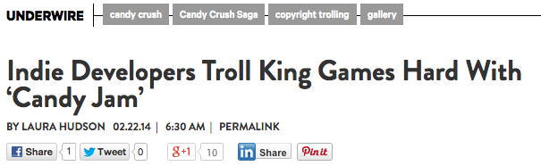
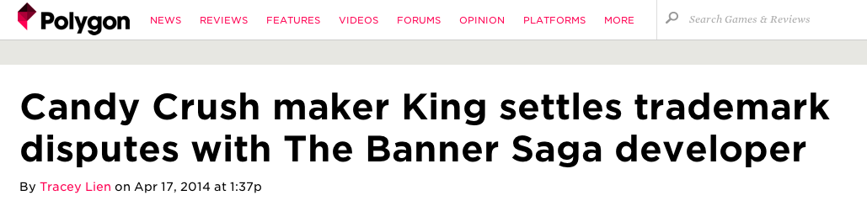
Candy Crush 2

Slide 74
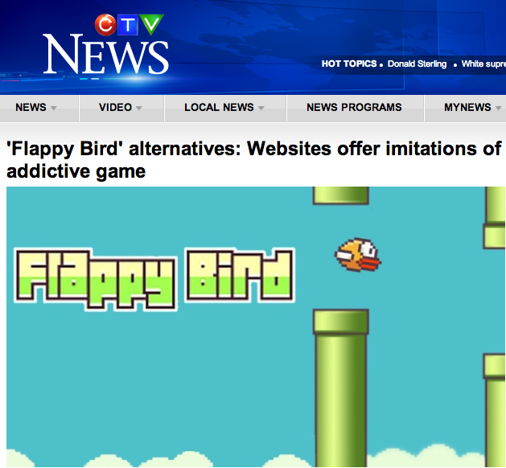

Slide 75


& most recently…

Slide 76
& most recently…
Pending in California Ct.

Slide 77
Footnote A
Trademarks

Slide 78







Blingville & Zynga
Consent judgment under which Blingville name or any other expression that
might affect Zynga's stable of trademarks, won’t be used.

Slide 79


The Learning Co. & Zynga
On December 18, 2012, TLC and defendant Zynga entered into an out-of-court
Settlement and the case was voluntarily dismissed with prejudice.

Slide 80

ESS Entertainment & Rock Star
The Play Pen & The Pig Pen
Court dismisses Play Pen action.

Slide 81
Footnote B
Personality Rights

Slide 82

Karen Gravano & GTA V
Pending. Rockstar cites apparent weight difference in defence.

Slide 83

Lindsay Lohan v. GTA 5
Action pending.

Slide 84

Manuel Noriega v. Call of Duty
Judge dismisses ex-dictator Manuel Noriega's 'Call of Duty' lawsuit: Right of publicity outweighed by 1st Amendment

Slide 85


Lady Miss Kier & Space Channel 5
Court finds Lady Miss Kier not to be the inspiration.

Slide 86


Beaver & Bieber
Who knows – who cares…

Slide 87


No Doubt & Activision Publishing, Inc.
(No Doubt & Band Hero)
Grammy-winning band and Call of Duty publisher agree on settlement over 2009 lawsuit
related to the use of the band's likeness in Band Hero; terms not disclosed.

Slide 88


Dillinger & Electronic Arts
John Dillinger & “Dillinger Tommy Gun”
EA Knocks Off Dillinger Heirs' Trademark Suit

Slide 89
Footnote C
Patent Rights

Slide 90


Crazy Taxi v. Simpsons Road Rage
Settled.

Slide 91


Golden Tee v. PGA Tour Golf
Defendant PGA Tour Golf wins.

Slide 92

So just what is
“Originality” ??

Slide 93



Is Creativity More
Important Than
Property ?

Slide 94

Course Review:
Emergent Themes

Slide 95
1. Why is Law slow in dealing with advancing technology ?

Slide 96
Dialectic between factors…
Copyright & I.P. orthodoxies
Fear of creativity
Political control issues
Industry incumbencies
Greed & financial control
Which is in service to which?

Slide 97
2. The post-IP world where contracts are paramount
Triple analysis seemingly needed on every issue relating to digital creativity:
What is the legal position re X ?
How much of the traditional legal position re X has been ceded to the operation of contract law ?
Are their any “super-remedies” (constitutional, privacy or consumer protection) ?

Slide 98

3. Does “(Digital)” in
“(Digital) Creativity” matter?
Yes it does.
Because of it’s exponential
amplifying effect.
Digital scales:
One copy or millions;
Viral friendly;
Plays seamlessly with “borderless” view of the net

Slide 99



4. Creativity is “connected”

Slide 100

Have a great break !
Next time:
Contracting out…of reality…

Slide 101
AND…
Special thanks to Jennifer
Kelly of Fenwick West for
allowing me to “remix”
some of her materials…

Slide 102

Always include a cat picture

Slide 103
Our Academic Partners

